Slide 1

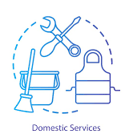

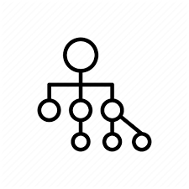

holagraph
How can we increase women participation using market networks
A Decline in Female Labour Force Participation has been observed in
post-reform India
Main reasons for decline in women participation
Changing Domestic Responsibilities
Increase In Household Income
Structural Factors
-As older girls enter and remain in school, task of chores and care giving performed by them now has to be performed by young Adult women
-Greater nuclearization and gender chore gap also contribute
--lessening of financial necessity
-women staying at home are often considered to reflect a rise in a family’s social status
-Patriarchal hierarchy, sexual harassment and lack of infrastructure at workplace
-Economic growth driven by service sector required high skill which majority of women did not possess
How can holagraph help leveraging market networks ?
SKILLSET ENHANCEMENT
Facilitate online learning from home
Enable training loans about USD 100-3000
FLEXIBILITY
Availability of part-time , flexible and work from home options
Connecting women with jobs in their own district
ENTERPRENEURSHIP
Aids access to loans through alternate credit scoring
Helps connecting with right talent and business partners to kickstart and grow business
We have an opportunity to increase India’s GDP by
27%
if women participation in the workforce increases to the same extent as men
Sign up to be a part of the holagraph community today.

Slide 2
holagraph
How can holagraph help leveraging market networks ?
(Variation)
01
FLEXIBILITY
Availability of part-time , flexible and work from home options
Connecting women with jobs in their own district
03
Entrepreneurship
02
Aids access to loans through alternate credit scoring
Helps connecting with right talent and business partners to kickstart and grow business
SKILLSET ENHANCEMENT
Facilitate online learning from home
Enable training loans about USD 100-3000
ENTERPRENEURSHIP
Challenges
Education/
Knowledge Access
Social Mobility
Credit Access
Market Network Solutions
Online training programs and topic wise learning options
Connecting with talent and business partners online
Alternate Credit Scoring helps in loan attainment

